Slide 1

Emotional Disorders/Behavioral Disorders: Neurobiological Perspectives on Assessment & Intervention
  TASP
OCTOBER 17, 2014

Slide 2
OVERVIEW
THESIS: The construct of social maladjustment is obsolete and needs to be revised.
QUESTIONS:
Does SM exist?
Are ED and BD (SM) different?
Can we differentiate?
Can we treat?
At what age can we know?
Notes:
Charles Joseph Whitman (June 24, 1941 – August 1, 1966) was an American engineering student and former U.S. Marine, who killed sixteen people and wounded thirty-two others in a mass shooting rampage in and around the Tower of the University of Texas in Austin on the afternoon of August 1, 1966. Three people were shot and killed inside the university's tower and eleven others were murdered after Whitman fired at random from the 28th-floor observation deck of the Main Building. Whitman was shot and killed by Austin police officer Houston McCoy.[1][2][3][4][5]
Prior to the shootings at the University of Texas, Whitman had murdered both his wife and mother in Austin. The shooting would remain the deadliest shooting on a U.S college campus until the Virginia Tech massacre in 2007.

Slide 3
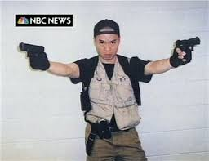
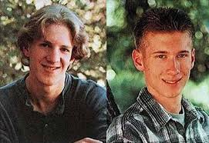
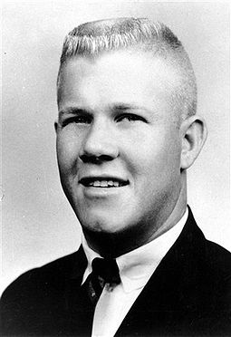
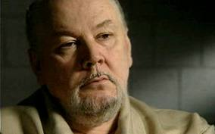
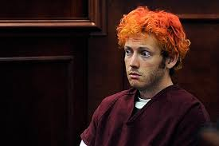
IS THIS SM?
Are these individuals Socially Maladjusted?
Notes:
Charles Joseph Whitman (June 24, 1941 – August 1, 1966) was an American engineering student and former U.S. Marine, who killed sixteen people and wounded thirty-two others in a mass shooting rampage in and around the Tower of the University of Texas in Austin on the afternoon of August 1, 1966. Three people were shot and killed inside the university's tower and eleven others were murdered after Whitman fired at random from the 28th-floor observation deck of the Main Building. Whitman was shot and killed by Austin police officer Houston McCoy.[1][2][3][4][5]
Prior to the shootings at the University of Texas, Whitman had murdered both his wife and mother in Austin. The shooting would remain the deadliest shooting on a U.S college campus until the Virginia Tech massacre in 2007.

Slide 4
What Defines Them?
Predation? Mental Illness? Behavior?
Notes:
Charles Joseph Whitman (June 24, 1941 – August 1, 1966) was an engineering student and former U.S. Marine, who killed sixteen people and wounded thirty-two others in a mass shooting rampage in and around the Tower of the University of Texas in Austin on the afternoon of August 1, 1966. Three people were shot and killed inside the university's tower and eleven others were murdered after Whitman fired at random from the 28th-floor observation deck of the Main Building. Whitman was shot and killed by Austin police officer Houston McCoy.[1][2][3][4][5]
Prior to the shootings at the University of Texas, Whitman had murdered both his wife and mother in Austin. The shooting would remain the deadliest shooting on a U.S college campus until the Virginia Tech massacre in 2007.

Slide 5
PREDATORS
Notes:
Charles Joseph Whitman (June 24, 1941 – August 1, 1966) was an engineering student and former U.S. Marine, who killed sixteen people and wounded thirty-two others in a mass shooting rampage in and around the Tower of the University of Texas in Austin on the afternoon of August 1, 1966. Three people were shot and killed inside the university's tower and eleven others were murdered after Whitman fired at random from the 28th-floor observation deck of the Main Building. Whitman was shot and killed by Austin police officer Houston McCoy.[1][2][3][4][5]
Prior to the shootings at the University of Texas, Whitman had murdered both his wife and mother in Austin. The shooting would remain the deadliest shooting on a U.S college campus until the Virginia Tech massacre in 2007.

Slide 6
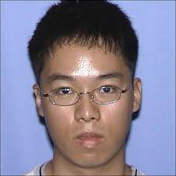

MENTAL HEALTH/MENTAL ILLNESS
Notes:
Charles Joseph Whitman (June 24, 1941 – August 1, 1966) was an engineering student and former U.S. Marine, who killed sixteen people and wounded thirty-two others in a mass shooting rampage in and around the Tower of the University of Texas in Austin on the afternoon of August 1, 1966. Three people were shot and killed inside the university's tower and eleven others were murdered after Whitman fired at random from the 28th-floor observation deck of the Main Building. Whitman was shot and killed by Austin police officer Houston McCoy.[1][2][3][4][5]
Prior to the shootings at the University of Texas, Whitman had murdered both his wife and mother in Austin. The shooting would remain the deadliest shooting on a U.S college campus until the Virginia Tech massacre in 2007.

Slide 7

BEHAVIOR AT SCHOOL
BAD CHOICES?
DISOBEDIENCE?
DEFIANCE?
ATTITUDE?
Notes:
Charles Joseph Whitman (June 24, 1941 – August 1, 1966) was an engineering student and former U.S. Marine, who killed sixteen people and wounded thirty-two others in a mass shooting rampage in and around the Tower of the University of Texas in Austin on the afternoon of August 1, 1966. Three people were shot and killed inside the university's tower and eleven others were murdered after Whitman fired at random from the 28th-floor observation deck of the Main Building. Whitman was shot and killed by Austin police officer Houston McCoy.[1][2][3][4][5]
Prior to the shootings at the University of Texas, Whitman had murdered both his wife and mother in Austin. The shooting would remain the deadliest shooting on a U.S college campus until the Virginia Tech massacre in 2007.

Slide 8
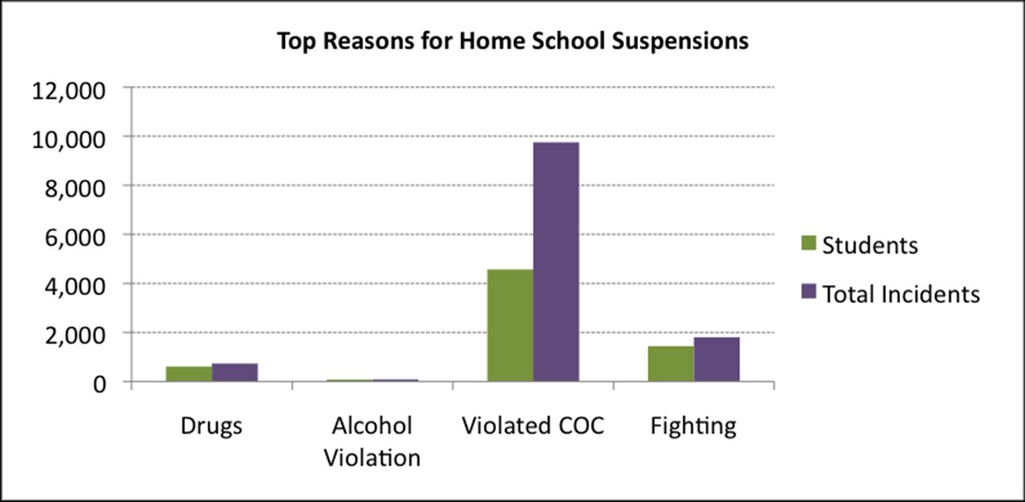
Reason for Suspensions
Notes:
http://www.centex-communitydashboards.org/rb21/DisciplinaryReferrals.php

Slide 9
CONSIDER
3,328,750 = students suspended in a year.
Reason for Suspension*
weapons and drugs 5%
disruptive behavior & other 95%
Other : cell phone, dress code, pda, defiance and other COC violations
*One suspension triples the likelihood of jj

Slide 10
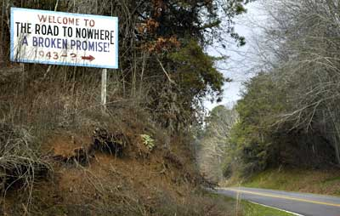
HOW’D WE GET HERE?
Punishment American Style
Standards Based Education
Columbine

Slide 11
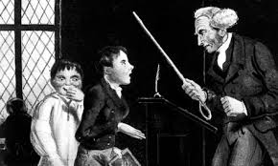
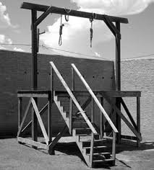
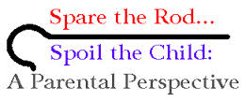
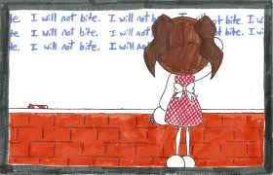
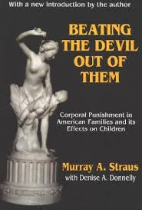
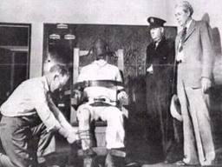
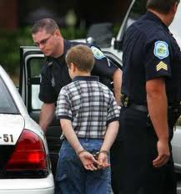
PUNISHMENT
GOVERNMENT SCHOOLS HOMES

Slide 12

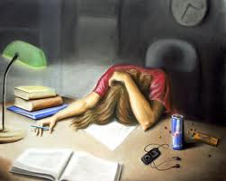
STANDARDS-BASED EDUCATION
1983 – A Nation at Risk (T. Bell)
1989 – Ed Summit (Bush I)
1994 – Goals 2000 (standards)
1996 – The National Reading Panel
2001 - NCLB

Slide 13

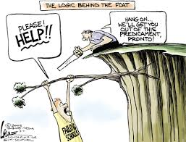
Standards-Based “Reforms”
high stakes testing
recess time
increased instructional time
accountability
choice/privatization
(Find the Underachievers
And Punish Them).
Notes:
It is believed to be the educational equivalent of a planned economy which attempts to require all children to perform at world-class levels merely by raising expectations and imposing punishments and sanctions on schools and children who fall short of the new standards. http://en.wikipedia.org/wiki/Standards-based_education_reform_in_the_United_States

Slide 14
THE CONUNDRUM THAT WAS CREATED
How do schools think about and manage students who are disruptive, defiant, and disobedient when confronted with AYP, high-stakes testing, school grades, and teacher evaluations?
Notes:
Editorial • Stop the School-to-Prison Pipeline
By the editors of Rethinking Schools

Slide 15
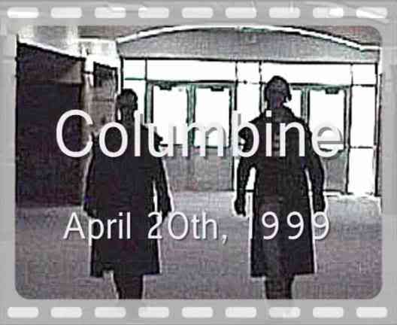
AND THEN…

Slide 16
SCHOOLS RESPOND TO SHOOTERS
Zero Tolerance
Suspension
Expulsion
Police Presence
Alternative Education

Slide 17
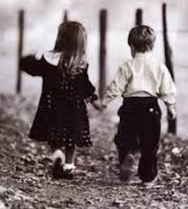
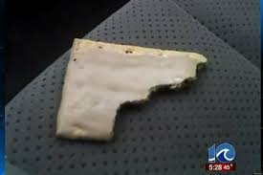
UNINTENDED CONSEQUENCES
We are criminalizing
developmentally appropriate
behavior.
We are recognizing some (not all)
mental illness. And what about
mental health?
We are using punishment as
intervention.

Slide 18
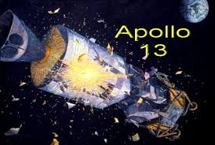

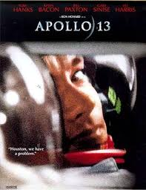
HOUSTON, WE HAVE A PROBLEM!!!!
Actually we have two

Slide 19

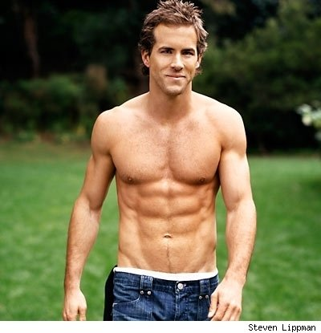
Problem 1:
Definition

Slide 20
EMOTIONAL DISTURBANCE
Specified by Bowers in 1957; published in 1981... .
Original Definition: The Emotional Disturbance had to be SERIOUS and students had to demonstrate:
an inability to learn
an inability to build relationships
inappropriate behavior or feelings
pervasive unhappiness/depression
physical symptoms or fears

Slide 21
AND THEN….
Bowers added this exclusionary clause:
“The term does not include children who are socially maladjusted, unless it is determined that they are seriously emotionally disturbed.”

Slide 22
TX DEPT. OF EDUCATION
Emotional disturbance means a condition exhibiting one or more of the following characteristics over a long period of time and to a
marked degree that adversely affects a child’s educational performance:
(A) – (E). Identical to Bower’s and the federal definition
Emotional disturbance includes schizophrenia. The term does not apply to children who are socially maladjusted, unless it is determined that they have an emotional disturbance under
paragraph (c)(4)(i) of this section.
SOURCE: Special Ed Rules & Regulations http://framework.esc18.net/Documents/Side-by-Side%20MAR%202012.pdf

Slide 23
LEGAL ATTEMPTS
Doe v. Board of Education of the State of Connecticut, social maladjustment can be defined as “a child who has a persistent pattern of violating societal norms with truancy, substance abuse, a perpetual struggle with authority, is easily frustrated, impulsive, and manipulative” (Whitted, 2008, para. 4).
Springer v. Fairfax County School Board, defined social maladjustment as “a child who is incapable of fully profiting from general educational programs of the public schools because of some serious social or emotion handicap but who is not expected to profit from special education” (Whitted, 2008, para. 5).
Whiskey—Tango--Foxtrot

Slide 24
A False Dichotomy
“The notion that emotional disturbance can be distinguished from social maladjustment is a false dichotomy… and it has created a controversy that continues to hamper efforts to provide intervention services to students who need them” (Gresham)

Slide 25

The False Dichotomy
By focusing on behavior
we create one problem
By insisting on a dichotomy
we create a second problem

Slide 26
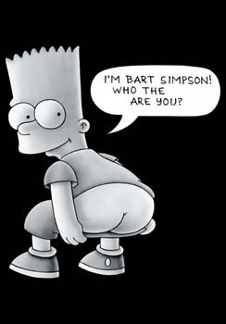
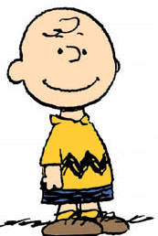
Socially Maladjusted
Emotionally Impaired

Slide 27
SOCIAL MALADJUSTMENT
Infers behavior that is under conscious control; students with behavior problems CAN control their behavior, but they are choosing not to.
In other words:
If you have an INTERNALIZING disorder (depression, anxiety) you have an emotional disorder and involuntary deviance.
If you have an EXTERNALIZING disorder (ADHD, ODD, CD) you have a behavior disorder and you are choosing deviant behavior.

Slide 28
WHAT IS SM?
Never defined in federal regulations
No agreement among states or in literature
So, we resort to DSM criteria for ODD and CD
Notes:
MERRELL & WALKER (2004)

Slide 29
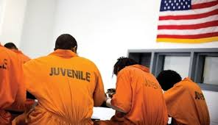

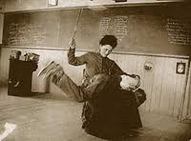
Problem 2:
Identification & Intervention
If it is assumed that BD (externalizing disorders) are about rule breaking and are somehow under voluntary control (“you’re making bad choices”)… a certain class of interventions
suggest themselves.
They are?
Are they effective?

Slide 30
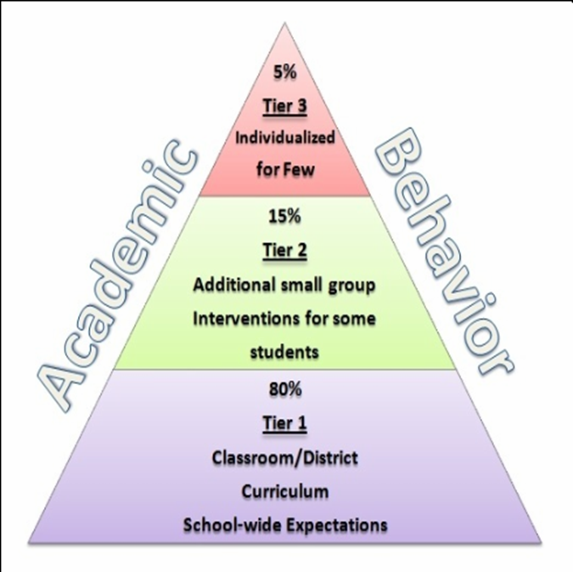
WHO CONCERNS US?
RULE BREAKERS?
The 20% who
emigrate from Tier I

Slide 31
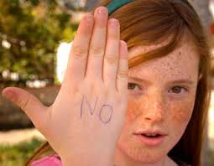
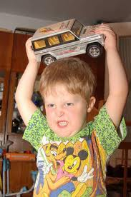
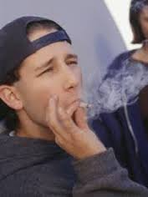

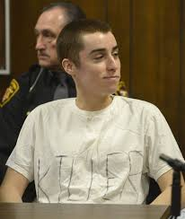
WHO ARE THE EMIGRANTS?
DEFIANT
DANGEROUS
DISRUPTIVE
DISOBEDIENT

Slide 32
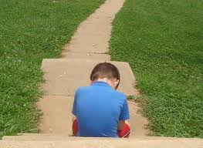
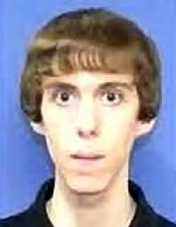
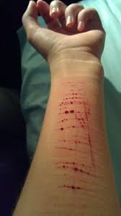
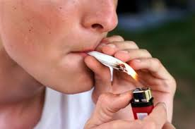
DIFFERENTIATING THE EMIGRANTS
TRANSIENT
UNDERSOCIALIZED
PSYCHOPATHS/
SOCIOPATHS
MENTAL ILLNESS

Slide 33

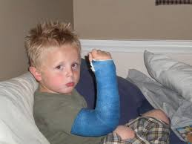
Transients
(Short-Term)
Divorce
Death
Relocation
Military Service
Job Loss

Slide 34
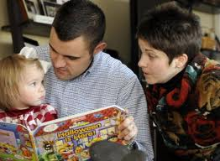

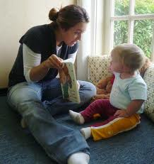

UNDERSOCIALIZED
WE ASSUME ALL STUDENTS ARE PREPARED FOR SCHOOL
ARE THEY?

Slide 35
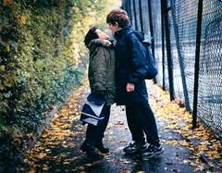

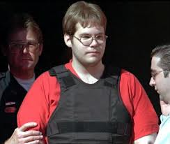

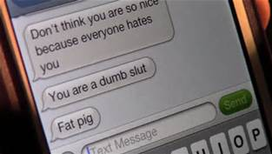
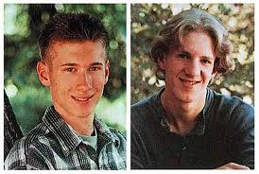
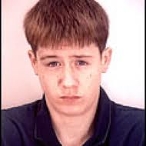
PSYCHOPATHS/SOCIOPATHS
Notes:
Kip Kinkel, Luke Woodham

Slide 36
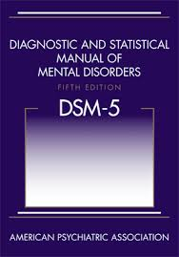
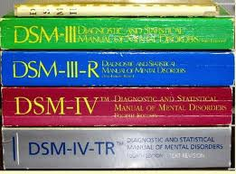
THE MENTALLY ILL

Slide 37
Children’s Mental Health
20%--k-12 who meet diagnostic criteria for mental illness.
5,000,000--children and adolescents in the U.S. suffer from a serious mental disorder that causes significant functional impairments at home, at school, and with peers.
80% -- fail to be identified and to receive treatment
6 – 8 years – from onset to treatment for mood disorders (8.38 years for BPD)
9 -23 years – from onset to treatment for anxiety disorders
Information obtained from National Alliance on Mental Illness web site Aug. 2007
Notes:
This slide is from Diane Kratt’s presentation; 5 million from WebMD; age of onset years from Kuehn

Slide 38
How Do Schools Respond to Emigrants’ Behavior?
Zero Tolerance Policies
Suspension
Expulsion
Police Presence
Alternative Education
Are These Evidence-Based Interventions?

Slide 39
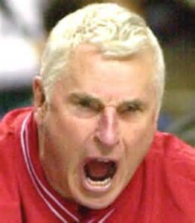
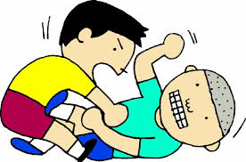
SAME BEHAVIOR
DIFFERENT EXPLANATION
Disruptive Behavior Disorders
Autism Spectrum Disorders
Anxiety Disorders
Mood Disorders
Psychotic Disorders
Adjustment & Attachment Disorders
Post Traumatic Stress Disorder
Abuse and Neglect
Substance Abuse Disorders

Slide 40
BEYOND TIER I, IT’S MORE THAN BAD CHOICES
Disruptive Behavior Disorders
Autism Spectrum Disorders
Anxiety Disorders
Mood Disorders
Psychotic Disorders
Adjustment & Attachment Disorders
Post Traumatic Stress Disorder
Abuse and Neglect
Substance Abuse Disorders

Slide 41
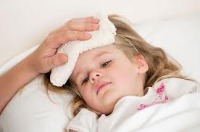
THE CHALLENGES
HOW DO WE DIFFERENTIATE ED/BD
MORE THAN BEHAVIOR
six children with coughs (fever)
While the morphology of a
behavior may be the same, explanations for a behavior can be vastly different.
DIFFERENT EXPLANATION = DIFFERENT INTERVENTION

Slide 42
WHAT MAKES AN ÉMIGRÉ?
Genetic Risk (Diathesis)
Environmental Influences (Stress)

Slide 43
GENETIC RISK
Chromosomal Abnl (Tri 21)
Single Genetic Mutation (Huntington’s)
Polygenic/Pleiotropic Disorders (personality, behavior, psychiatric)
Notes:
Polygenic = trait is influenced by more than one gene; plieotropic – one gene affects multiple systems (PKU)

Slide 44
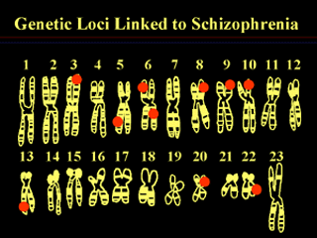

Schizophrenia (ASD)
    POLYGENIC
STRUCTURAL

Slide 45
ENVIRONMENTAL STRESSORS
Adverse Childhood Experiences Study (ACES)
10 categories of early stressors
Direct relationship between ACE score and adult health outcomes (including sub.abuse, mental/physical ill.).

Slide 46


EPIGENETICS
Stress, diet, behavior, toxins, and other factors regulate gene expression (AND BEHAVIOR).

Slide 47
DSM V DISORDERS OF CHILDHOOD
EARLY ONSET
Neurodevelopmental (ADHD; LD)
    Schizo & Psychotic
INTERNALIZING
Bipolar & Related Depressive Anxiety OCD Personality Trauma Dissociative Feeding & Eating Elimination Sleep-Wake
EXTERNALIZING
Disruptive, Impulse Control, ODD, CD
Substance Abuse & Addiction

Slide 48

DSM V INTERNALIZING DISORDERS
Neurodev. Dis. (IQ, ADHD, ASD, COMM)
Schizo & Other Psychotic Disorders
Depressive (DMDD)
Anxiety
OCD
Trauma (PTSD)
Dissociative
Somatic
Feeding & Eating Elimination Sleep-Wake

Slide 49

SCHIZOPHRENIA & THE BRAIN
Structural – enlarged ventricles; decreased volume of gray and white matter; smaller hippocampus and amygdala
Functional – decrease blood
flow and metabolism in
frontal lobes

Slide 50

DOPAMINE HYPOTHESIS
Substantia nigra
and Parkinson’s
Ventral Tegmentum
and schizophrenia
Notes:
http://www.nimh.nih.gov/health/publications/schizophrenia/what-is-schizophrenia.shtml

Slide 51

ASD

Slide 52

DEPRESSION
SEROTONIN
Mood
Emotion
Sleep
Appetite

Slide 53


ANXIETY
Most Anxiety Disorders result from exaggerated fear response
STRUCTURAL
Amygdala
Insula
CHEMICAL ANOMALIES (Limbic Dysregulation)
serotonin depletion
excessive glutamate
insufficient GABA)
release of cortisol & adrenaline (increased arousal)

Slide 54

OCD
STRUCTURAL ANOMALIES
Less white matter connecting basal ganglia to PFC
Hypermetabolic in left orbital-frontal cortex that
over-stimulates the “worry circuit”
caudate n. – thought switching
cingulate g. – dread
thalamus – proc. sensory inputs
Smaller dorsal anterior cingulate
Smaller right anterior insula
NEUROCHEMICAL ANOMALIES
reduced serotonin

Slide 55
EXTERNALIZING DISORDERS
Disruptive Disorders, Impulse-Control, and Conduct Disorders
Oppositional Defiant Disorder
Intermittent Explosive Disorder
Conduct Disorder
Child Onset
Adol Onset
Antisocial Personality Disorder
Pyromania
Kleptomania

Slide 56

What Is It About Externalizing Disorders?
Behaviors that violate the rights of others (aggression, property destruction).
Bring the individual into conflict
with authority figures and/or
societal norms.

Slide 57
What Is It About Externalizing Disorders?
Are Ext. Disorders Always Voluntary?
Are Ext. Disorders Always Predatory?
Are Ext. Disorders Brain-Based?

Slide 58


TWO COMPETING REGIONS
PREFRONTAL CORTEX
(altricial)
LIMBIC SYSTEM
(precocial)

Slide 59

The Frontal Lobes
Executive Functions
anticipation
organization
memory
planning
Affective Functions
expression
inhibition
Notes:
Anterior cingulate (green) is the executive assistant.

Slide 60
FRONTAL LOBE DEFICITS
11% reduction in PFC in APD
17% reduction in PFC in TLE with IED
PREFRONTAL CORTEX
Notes:
http://www.psych-it.com.au/Psychlopedia/article.asp?id=191 (dorsolateral)

Slide 61

VENTROMEDIAL PREFRONTAL CORTEX
cost-benefit analysis based on emotional value
decision-making and consideration
of future consequences
children with EOBPD show increased
activation in VMPFC when viewing
emotional pictures.
Notes:
Davidson, Putnam, Larson (2000).

Slide 62
ORBITAL PREFRONTAL CORTEX
Cost-benefit analysis based on
cognitive assessment.
The Orbital PFC and the ACC
regulate our response when we are
angry.
Smaller left OFC and Borderline
Personality Disorder
Notes:
Davidson, Putnam, Larson (2000). Smaller left Orbital PFC volume
associated with borderline personality
disorder.

Slide 63


LIMBIC SYSTEM
Adds emotional value to sensory information.
Alerts us to threats in the immediate environment.
And the PFC decides what to do about this information.

Slide 64


LIMBIC SYSTEM
ANTERIOR CINGULATE—mistake detection (and learning from mistakes); adaptive learning
AMYGDALA—fear response; flight/flight; fear memories.
HIPPOCAMPUS—spatial memory; memory
consolidation.
INSULA - empathy

Slide 65

INSULA
Social Emotions (pride; disgust; guilt; lust)
Morality; Empathy
Monitors appetites and seeks to satisfy them (addiction; eating disorders)
Receives inputs from body’s sense receptors.
Notes:
Davidson, RJ, Putnam, KM, Larson, CL. (2000). Dysfunction in the neural circuitry of emotion regulation. A possible prelude to violence. Science. 289 (5479). 591-194.
green (A) = orbital prefrontal cortex
red (A) = ventromedial prefrontal cortex
blue (B)= dorsolateral prefrontal cortex
gold (C) = amygdala
yellow (D) = anterior cingulate cortex

Slide 66

CINGULATE CORTEX
ACC dysfunction is associated
with decreased ability
to monitor conflict
between what we know
(memory) and current
circumstances from
sensory inputs.

Slide 67

CINGULATE CORTEX
The ability to alter behavior to match the social context
We behave differently
in class than at the game

Slide 68

CINGULATE CORTEX
Children with BPD have smaller
cingulate cortex
Smaller right anterior cingulate
cortex associated with borderline
personality disorder.
They don’t adjust & adapt to
their environment
Notes:
Davidson, Putnam, Larson (2000).

Slide 69

AMYGDALA and BiPD
Smaller volume
BPD patients perceived greater hostility in neutral faces
Notes:
SOURCE: BHAGWAGAR (2008)

Slide 70

THE AMYGDALA AND DEFENSIVE AGGRESSION

Slide 71

Now, About This Dichotomy
Disruptive, Impulse-Control, CD
ADHD (Neurodev)
ODD
IED
CD
ASPD
Pyromania
Kleptomania

Slide 72



NEUROBIOLOGICAL CORRELATES (ADHD)
Electrophysiological (QEEG; ERP)
  reduced electrical activity in the right
  prefrontal regions (sustained attention)
Structural (MRI)
  lack of frontal asymmetry
  smaller basal ganglia
  not brain damage, just smaller
Blood Flow (rCBF; fMRI)
  reduced blood flow to the frontal lobes
  increased with MPH (Vaidya, 1998)
Notes:
Pliszka et al., 2000)

Slide 73
ODD
Anatomical Differences
frontal cortex
reduced glucose metabolism (PET)
EEG reduced lower left frontal (ED)
reduced volume in ASP (Raine)
amygdala
perception of social cues
overactive in BPD (borderline)
Notes:
First 3 are from Serra-Pinheiro et al; “Cortisol is secreted in response to stressful or threatening situations. Low levels may indicate how these young males will respond to potentially stressful situations, suggests McBurnett. "Boys with consistently lower cortisol levels may not be as afraid of retribution," he suggested. "In many aggressive children, the system that responds to the threat of punishment does not react normally. They may not feel stress in the same way and so they don't avoid stressful situations.“ (aggression on desktop).
Baving et al.

Slide 74
ODD
Neurochemical Differences
lower dopamine (emotional expression) lower serotonin (emotional inhibition)*
lower norepinephrine (inhibition)
higher adrenal androgens/testosterone
lower median cortisol levels
*serotonin does not activate the frontal cortex.
Notes:
First 3 are from Serra-Pinheiro et al; “Cortisol is secreted in response to stressful or threatening situations. Low levels may indicate how these young males will respond to potentially stressful situations, suggests McBurnett. "Boys with consistently lower cortisol levels may not be as afraid of retribution," he suggested. "In many aggressive children, the system that responds to the threat of punishment does not react normally. They may not feel stress in the same way and so they don't avoid stressful situations.“ (aggression on desktop).

Slide 75
ODD
AUTONOMIC NERVOUS SYSTEM
lower baseline heart rates (Raine);
lower skin conduction
underaroused ANS - lower disinhibition & fearfulness (We don’t scare them)
Notes:
First 3 are from Serra-Pinheiro et al; “Cortisol is secreted in response to stressful or threatening situations. Low levels may indicate how these young males will respond to potentially stressful situations, suggests McBurnett. "Boys with consistently lower cortisol levels may not be as afraid of retribution," he suggested. "In many aggressive children, the system that responds to the threat of punishment does not react normally. They may not feel stress in the same way and so they don't avoid stressful situations.“ (aggression on desktop).

Slide 76
CONDUCT DISORDERS
STRUCTURAL DIFFERENCES
Smaller amygdala (perception of environmental cues; facial expression; recognizing distress in others)
Smaller insula (empathy);
Smaller anterior cingulate cortex (monitors performance and reward and adjusts behavior to environment)
Notes:
FROM SUSMAN, 2006
Also, cortisol mobilizes energy for flight/fight; when it reaches a certain level, it triggers the stress response system to return to normal).
Low cortisol in McBurnett et al 2000.

Slide 77
CONDUCT DISORDERS
CHEMICAL DIFFERENCES
LOWER CORTISOL (in aggressive males; in habitual violent offenders; CD girls)
underarousal leads to stimulation-seeking behavior
impedes learning from aversive events
LOWER CATECHOLAMINES
lower DOPAMINE (emotional expression; stimulation seeking) lower SEROTONIN (reduced emotional inhibition)
lower NOREPINEPHRINE (less inhibition)
  in aggressive children (beginning at age 3)
  in adult criminals & violent offenders
INCREASED TESTOSTERONE & ADRENAL ANDROGEN
LOWER GABA
Notes:
FROM SUSMAN, 2006
Also, cortisol mobilizes energy for flight/fight; when it reaches a certain level, it triggers the stress response system to return to normal).
Low cortisol in McBurnett et al 2000.

Slide 78

WHERE DO WE GO FROM HERE?

Slide 79

STEP ONE
DIFFERENTIAL
DIAGNOSIS
(OF PEOPLE, NOT
BEHAVIOR)
Notes:
IT’S MORE THAN BEHAVIOR

Slide 80

Effective Intervention at T2 and T3
Is More Than Behavior
Who is this student?
What is impaired?

Slide 81
DIFFERENTIATING THE EMIGRES
TRANSIENT
UNDERSOCIALIZED
PSYCHOPATHS/
SOCIOPATHS
MENTAL ILLNESS

Slide 82
GROUPS ONE & TWO
TRANSIENT (HX) yes ___ no ___
UNDERSOCIALIZED yes ___ no ___
You’ll know by third grade
Teachers as Parents

Slide 83

GROUPS THREE AND FOUR
PSYCHOPATHS/SOCIOPATHS
Family History, Behavioral History
ACES, Temperament
Assessment (to rule out)
MENTAL ILLNESS
Assessment

Slide 84


WE HAVE TO GET THIS RIGHT
How Do I Differentiate?
What Do I Do About It?
Because mistakes are
costly…

Slide 85



A TALE OF TWO GIRLS’ HOMEWORK

Slide 86


THE HEAVY LIFTING……
INTERVENTIONS

Slide 87
Developing Effective Interventions for EI
Is About Two Things:
Who is this student?
What’s in/not in his
trunk?

Slide 88
A Comprehensive Functional Assessment
DIFFERENTIAL DIAGNOSTIC ASSESSMENT
Broad Band
Narrow Band
COGNITIVE/ACADEMIC ASSESSMENT
IQ, ACH, ATTENTION, MEMORY
NONCOGNITIVE ASSESSMENT
ALSUP
Emotional/Behavioral Rating Skills Inventory
FUNCTIONAL BEHAVIORAL ASSESSMENT
Triggers at school

Slide 89
DIFFERENTIAL ASSESSMENT
EXTERNALIZING DISORDERS
LEVEL I—BROAD BAND
Omnibus Rating Scales (CAB; BASC II)
History
Record Review
Interview
LEVEL II—NARROW BAND
Pediatric Behavior Rating Scale
Children’s Depression Inventory
Emotional Disorders Decision Tree

Slide 90

DIAGNOSTIC ASSESSMENT
BROAD BAND
BASC II
CAB
ASEBA
NARROW BAND
Pediatric Behavior Rating Scale
Children’s Depression Inventory
Emotional Disorders Decision Tree

Slide 91
Emotional Disturbance Decision Tree
Ages 5-18
Scales (match federal criteria)
  Inability to Build or Maintain Relationships
  Inappropriate Behaviors or Feelings
  Pervasive Mood/Depression
  Physical Symptoms or Fears.
Screening Clusters
  Attention-Deficit Hyperactivity Disorder
  Possible Psychosis/Schizophrenia
Level of Severity Cluster
Educational Impact Cluster (inability to learn)

Slide 92
COGNITIVE/ACADEMIC ASSESSMENT
PSYCHOEDUCATIONAL
IQ
ACHIEVEMENT
ATTENTION
MEMORY
EX FUNCTIONS

Slide 93
NONCOGNITIVE ASSESSMENT
WHAT IS IMPAIRED
LAGGING SKILLS

Slide 94


SKILL DEFICITS
(or BAD CHOICES?)
Emotional Regulation
Social Skills
Language Skills
Executive Functions
Academics

Slide 95
IMPAIRMENTS
DX | ER | AGG | US | SS | LANG | EF | WM | ATT | ACAD
ADHD | × |  | × | × | × | × | × | × | ×
CD | × | × | × | × | × | × |  |  | ×
ODD | × | × | × | × | × | × |  |  | ×
OCD | × |  |  | × | × | × |  |  | ×
BPD | × | × |  | × | × | × | × | × | ×
DEP | × |  |  | × | × | × | × | × | ×
ANX | × |  |  | × | × | × | × | × | ×
ASD | × | × | × | × | × | × | × |  | ×

Slide 96

ALSUP

Slide 97

Lagging Skills Also Compromise A Student’s Education
Handling transitions and shifting cognitive set
Maintaining focus
Considering the likely outcomes of one’s actions
Expressing needs and concerns in words
Managing emotional responses to frustration
Managing irritability and anxiety
Difficulty handling unpredictability, ambiguity, uncertainty.
Inaccurate interpretations of social cues
Social skills deficits
Appreciating how one’s behavior affects others
Notes:
Ross Greene. Lost at School (p. 14-15).

Slide 98
EMOTIONAL/BEHAVIORAL READINESS SKILLS INVENTORY (EBRSI).
 | Compared to other students in the classroom, rate the student’s relative skills … | Never | Sometimes | Often | Always
1 | Considers the likely outcomes of behaviors | N | S | O | A
2 | Acts impulsively | N | S | O | A
3 | Has difficulty handling transitions | N | S | O | A
4 | Internalizes (understands and implements) classroom/school rules | N | S | O | A
5 | Seems unable to follow directions | N | S | O | A
6 | Is disorganized | N | S | O | A
7 | Can consider multiple solutions to problems | N | S | O | A
8 | Cannot handle unpredictability & ambiguity | N | S | O | A
9 | Does not seem to understand what is said | N | S | O | A
10 | Has limited receptive vocabulary | N | S | O | A
11 | Pauses for long delays before responding | N | S | O | A
12 | Inaccurately responds | N | S | O | A
13 | Inaccurately interprets statements | N | S | O | A
14 | Has disorganized thoughts | N | S | O | A
15 | Cannot express feelings accurately | N | S | O | A

Slide 99
EMOTIONAL/BEHAVIORAL READINESS SKILLS INVENTORY (EBRSI).
16 | Has word finding difficulties | N | S | O | A
17 | Cannot elaborate verbally | N | S | O | A
18 | Has poor regulation of vocal pitch and volume of speech | N | S | O | A
19 | Cries easily | N | S | O | A
20 | Is able to resolve conflicts | N | S | O | A
21 | Difficulty controlling temper | N | S | O | A
22 | “Shuts down” | N | S | O | A
23 | Is irritable | N | S | O | A
24 | Acts sad or depressed | N | S | O | A
25 | Refuses to comply | N | S | O | A
26 | Appears tired or fatigued | N | S | O | A
27 | Has obsessive behaviors | N | S | O | A
28 | Is physically aggressive | N | S | O | A
29 | Is verbally aggressive | N | S | O | A
30 | Appears anxious | N | S | O | A
31 | Has difficulty seeing another person’s point of view. | N | S | O | A

Slide 100
EMOTIONAL/BEHAVIORAL READINESS SKILLS INVENTORY (EBRSI).
32 | Poorly perceives social cues | N | S | O | A
33 | Voices cognitive distortions (i.e., “it’s not fair”) | N | S | O | A
34 | Has problems with interpersonal relationships (peers and/or adults) | N | S | O | A
35 | Fails to see positive attributes about self | N | S | O | A
36 | Believes self to be better/superior to others despite difficulties | N | S | O | A
37 | Seeks attention inappropriately (i.e., “class clown,” interrupting, or intruding) | N | S | O | A
38 | Is unable to focus on one task at a time | N | S | O | A
39 | Is unable to maintain focus as needed for task | N | S | O | A
40 | Has perseverative behaviors | N | S | O | A

Slide 101
Who the Heck is Heckman?
A Nobel Prize Winning Econometrician who re-analyzed data from the Perry Preschool Project.
Here’s what he found.
No lasting gains in cognitive skills.
But, the Perry treatment group:
more likely to have graduated
more likely to be employed at 27
earning more than $25,000
less likely to have been arrested
less likely to have been on welfare
Notes:
Ross Greene. Lost at School (p. 14-15).

Slide 102


What The Perry Group Had
NONCOGNITIVE SKILLS
CURIOSITY
SELF-CONTROL
SOCIAL SKILLS
PERSISTENCE
MENTORS
Notes:
Ross Greene. Lost at School (p. 14-15).

Slide 103

LET’S PAUSE TO REVIEW
Current approaches are ineffective with 20%.
The behavior of concern is rarely the real issue.
Students (mis)behave to get their needs met.
With the 20%, it does matter why.
5. Differential Assessment Diff. Inter.
6. A case of involuntary deviance (brain difference)

Slide 104

LAGGING ACADEMIC SKILLS
SUBJECTS
METACOGNITION
EXECUTIVE FUNCTIONS
HOW TO “DO” SCHOOL
MOTIVATION = ACHIEVEMENT
Notes:
Source: Paul Tough How Children Succeed page xv.

Slide 105

LAGGING
NONCOGNITIVE SKILLS
Self-Regulation
Social Skills
Pragmatic Language
Executive Functions
Character
Notes:
Boys Town Social Skills

Slide 106
INTERVENTIONS
Are Not For Everybody
Notes:
SPED is a service, not a place

Slide 107


Back in the Day Discipline
Notes:
Dunce Cap = Duns Scotus mentioned that wizards had pointy hats; reverse funnels.

Slide 108





ALTERNATIVE

Slide 109
Shortcomings of Current Approaches
They rely on external control (when what we want is self-regulation).
They focus on behavior (not people).
They focus on behavior (AFTER it occurs).

Slide 110


We Continue to Rely On
Seven Deadly Habits
criticizing
blaming
complaining
nagging
threatening
punishing
rewarding
Notes:
THE PROBLEM WITH THESE IS THAT THEY FOCUS ON THE BEHAVIOR, NOT THE CHILD

Slide 111




NONCOGNITIVE INTERVENTIONS
1. focus on people not behavior.
2. do no harm.
3. consider the circumstances.
4. teach don’t punish

Slide 112
HOW DOES THIS OCCUR?
RtI (Gresham, 2013)-risk v deficit
Effective Practices (Landrum et al, 2003). Inter. for three deficits (behavior, academics, social)
Replace Reactive Punishment with Restorative Justice
Replace (Re)segregation with Universal Education
Notes:
44 Harv. C.R.-C.L. L. Rev. 547 (2009)
Restorative Justice in Schools: Learning from Jena High School; Suvall, Cara

Slide 113
RtI FOR ED (Gresham)
20% mental health problems; 1% - 2% served
Is educational performance limited to academics?
Are we using evidence-based inter with integrity?
Universal Interventions (Tier 1)(Are they in place?)
Selected Interventions (Tier 2)(Token E or Beh. Contract)
Targeted Interventions (5% of students; 50% of disruptions; 60% of resources)
Notes:
Gresham

Slide 114
Consequences (Landrum et al)
1. those that rely on reinforcement strategies (e.g.,
differential reinforcement of other behavior,
differential reinforcement of incompatible
behavior);
2. extinction (terminating reinforcement);
3. removal of desirable stimuli;
4. presentation of aversive stimuli (Alberto &
Troutman, 2003).
Notes:
What Is Special About Special Education for Students with Emotional or Behavioral Disorders? Timothy J. Landrum, Melody Tankersley and James M. Kauffman

Slide 115

RESTORATIVE JUSTICE
THE FAILURE OF PUNITIVE/EXCLUSIONARY DISCIPLINE
interferes with academic performance (drop outs)
alienates student from school
doesn’t address needs of victims
fails to address systemic problems
PUNITIVE/EXCLUSIONARY APPROACHES
destroy a student’s spirit
has no effect
worsens the problem
damages relationships
Notes:
44 Harv. C.R.-C.L. L. Rev. 547 (2009)
Restorative Justice in Schools: Learning from Jena High School; Suvall, Cara

Slide 116

RESEGREGATION OF AMERICA’S SCHOOLS
Brown v Board of Education 1954
Board of Education v. Dowell, 1991
TRACKING
CHARTER SCHOOLS
MAGNATE SCHOOLS
WHERE IS THIS GOING TO END?

Slide 117

WHAT TO DO
WHEN YOU DON’T PUNISH
EVENT
Isolation
De-escalation
De-escalation
Recovery
Prevention/Teaching
Re-Teaching
Relationships
Relationships

Slide 118


RELATIONSHIPS
Talk Time (pick # from 1- 40)
Team Building for Tweens
Getting to know you with TP.
Self-collage
Notes:
Ross Greene. Lost at School (p. 14-15).

Slide 119


PREVENTION versus TEACHING
Remember These Guys?
Notes:
B. F. Skinner (1971), remarked that ‘when we
punish a person for behaving badly, we leave it up to him to learn how to behave well’
(p. 69). Beyond Freedom and Dignity.

Slide 120



PREVENTION
A little stimulation (confrontation) goes a long, long way with emigres
Is homework worth it?
Is cotillion worth it?
Remember, the brain gets good at what it does
repeatedly.

Slide 121



TEACHING
NON-COGNITIVE SKILLS
Character
Persistence
Self-Regulation
Problem-Solving
Teaching “lessons” without disrupting lessons.

Slide 122



DE-ESCALATION
Validate their emotions
Have a cool down procedure
Model what you want

Slide 123




ISOLATION
Time Out Chill Out Escort Out
We can punish for a flame-out, or we can
give them a chance to recover and move
forward.

Slide 124





EVENT

Slide 125

DE-ESCALATION
Allow the child’s ANS to cool
DO NOT engage
DO NOT reason
DO NOT negotiate
Be Certain It’s Over

Slide 126


ANS RECOVERY
Take as long as needed Blow off steam
Allow separation from event
Teach relaxation techniques

Slide 127
RE-TEACHING
NON-COGNITIVE SKILLS
Character
Persistence
Self-Regulation
Problem-Solving
SEL
Teaching “lessons” without disrupting lessons.

Slide 128
RELATIONSHIPS
No matter what, you are still a member
Prodigals welcome
A teaching lesson

Slide 129
INTERESTING PERSPECTIVE
If antisocial and aggressive behavior is not changed by 3rd grade, it should be considered a chronic condition:
1. think care not cure
2. we need systems, including school systems, dedicated to providing ongoing support and intervention.
3. stop hoping for a cure with ABA and R and P!!!!!

Slide 130
LET’S PAUSE TO REVIEW
Current approaches are ineffective with 20%.
Behavior is a symptom; don’t stop there.
Students (mis)behave to get their needs met.
With ED/BD, it does matter why.
5. Differential Assessment Diff. Inter.
6. A case of involuntary deviance (brain differences).

Slide 131
THANK YOU!☺
RICHARD M. MARSHALL
UNIV OF SOUTH FLORIDA
richardm@usf.edu

